Slide 1
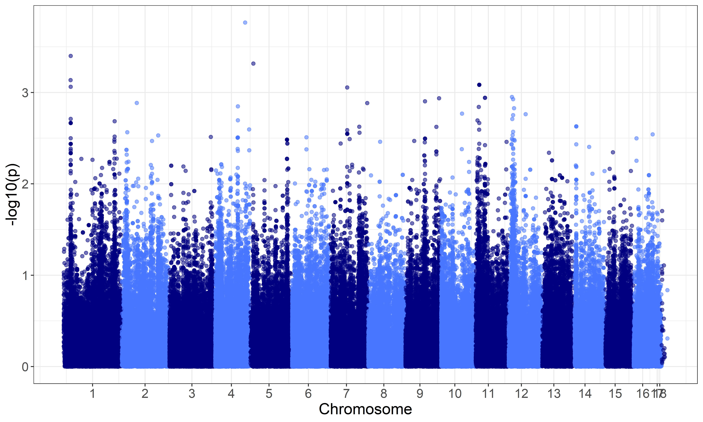
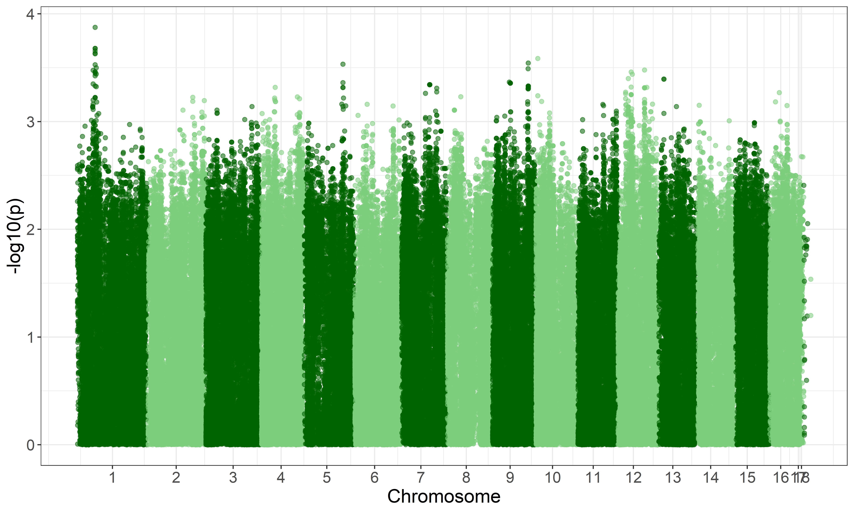
a.
3
2
-log₁₀(p)
1
0
1 2 3 4 5 6 7 8 9 10 11 12 13 14 15 16 17 18
b.
Chromosome
4
3
-log₁₀(p)
2
1
0
1 2 3 4 5 6 7 8 9 10 11 12 13 14 15 16 17 18
Figure 1. Manhattan plot examples for 1 transcript per species. Panel a is an example plot of p-values for all B. cinerea SNP associations to a single B. cinerea transcript, from Bcin01g00170. Panel b is an example plot of p-values for all B. cinerea SNP associations to a single A. thaliana transcript, from AT1G01010. Dashed line indicates significance at p = 0.01.

Slide 2
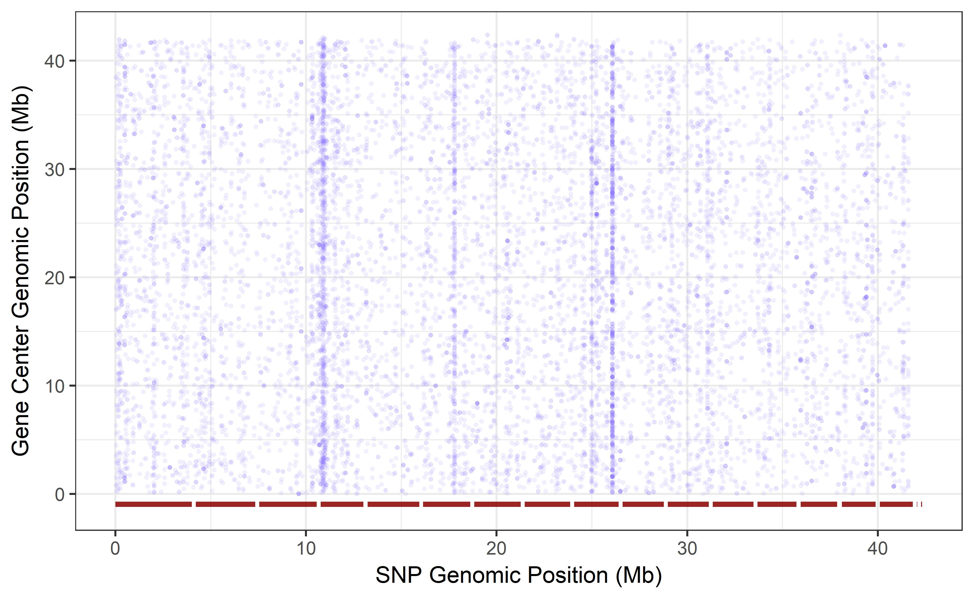
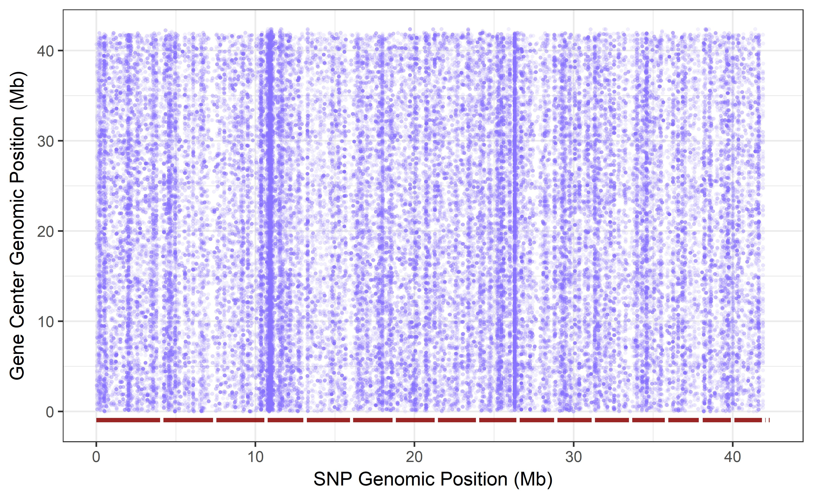
a.
40
30
Gene Center Genomic Position (Mb)
20
10
0
0 10 20 30 40
SNP Genomic Position (Mb)
b.
40
30
Gene Center Genomic Position (Mb)
20
b.
10
0
0 10 20 30 40
SNP Genomic Position (Mb)
Figure 2. cis-diagonal plot comparing B. cinerea gene center to position of top associated SNP, for all 9,284 transcripts mapped to the B. cinerea genome. We retained only the SNPs with highest probability (lowest p-value) of significant effect on expression for each transcript . Panel a depicts the single top SNP per transcript. Panel b depicts the top 10 SNPs per transcript. The 18 B. cinerea chromosomes are delimited by red bars along the x-axis, and positions indicate individual SNPs. The y-axis depicts the same chromosome alignment, but positions are the center of each mapped transcript. Vertical striping of SNP positions indicates genomic locations of putative trans-eQTL hotspots.

Slide 3
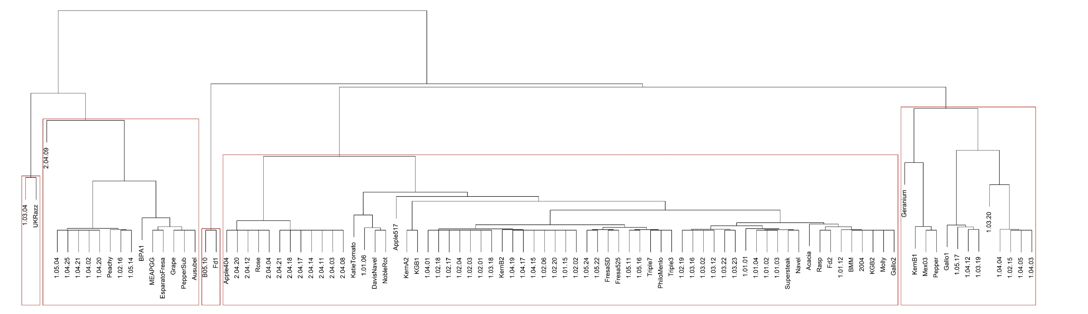
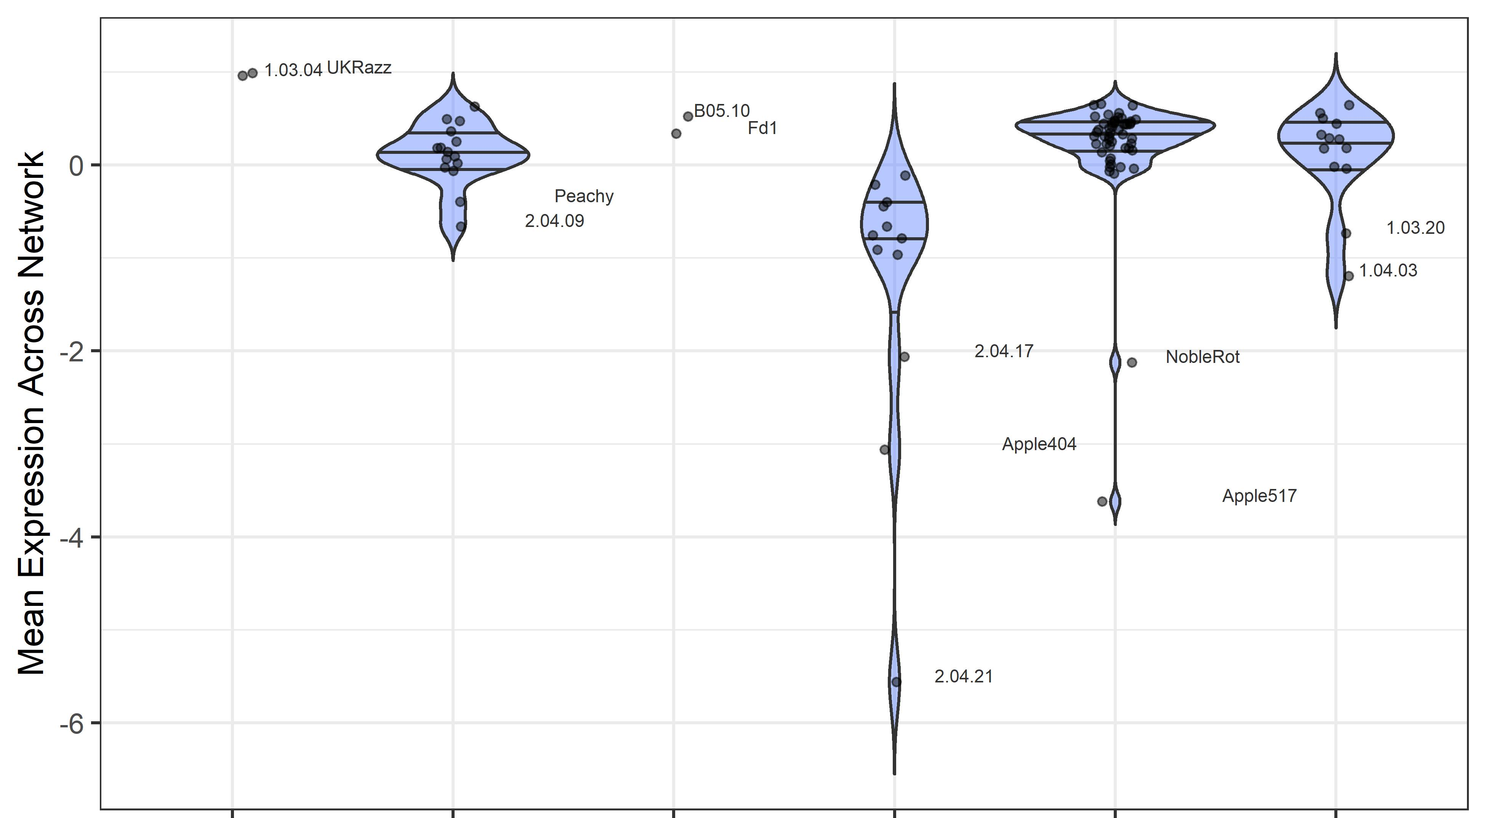
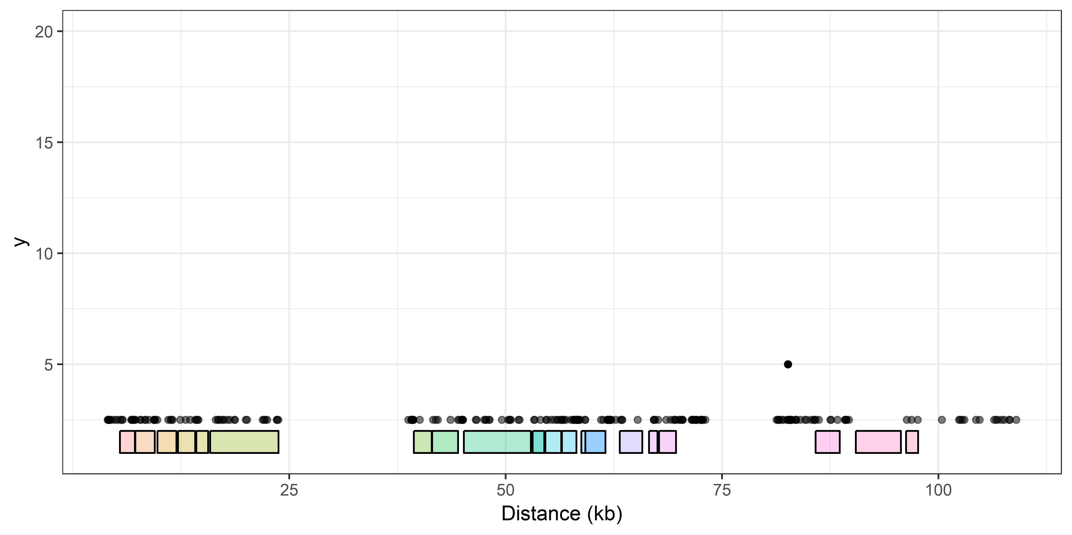
a.
Cluster Membership
1
2
3
4
5
6
b.
78.6kb deletion
Figure 3. cis-effect analysis of the botcinic acid biosynthetic gene network. Panel a is hierarchical clustering of B. cinerea isolates from SNPs within the botcinic acid biosynthetic gene network. Clustering was based on mean linkage (UPGMA), with correlation distance and 1000 bootstrap replications. AU p-values are reported in red, BP values in green. Edges with high AU values are considered strongly supported by the data, and clustering is drawn according to these edges with AU > 95%. Panel b is Violin plots of botcinic acid network-level expression within B. cinerea clusters. Isolates are clustered based membership in groups defined by hierarchical clustering of the SNPs within the botcinic acid biosynthesis network. Panel c is the gene models of the biosynthetic gene network, with each box delimiting a single gene (including Bcboa1 to Bcboa13 and 5 additional genes) and with the cluster 3 deletion indicated as a triangle.

Slide 4
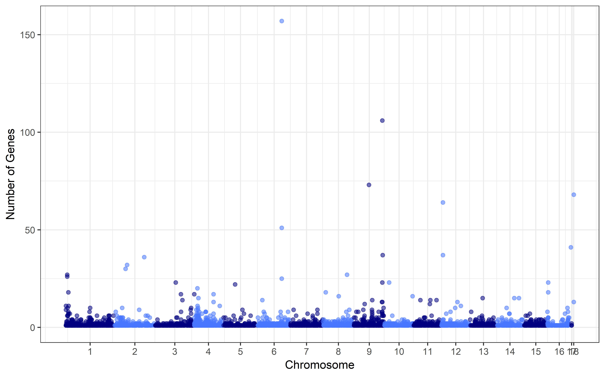
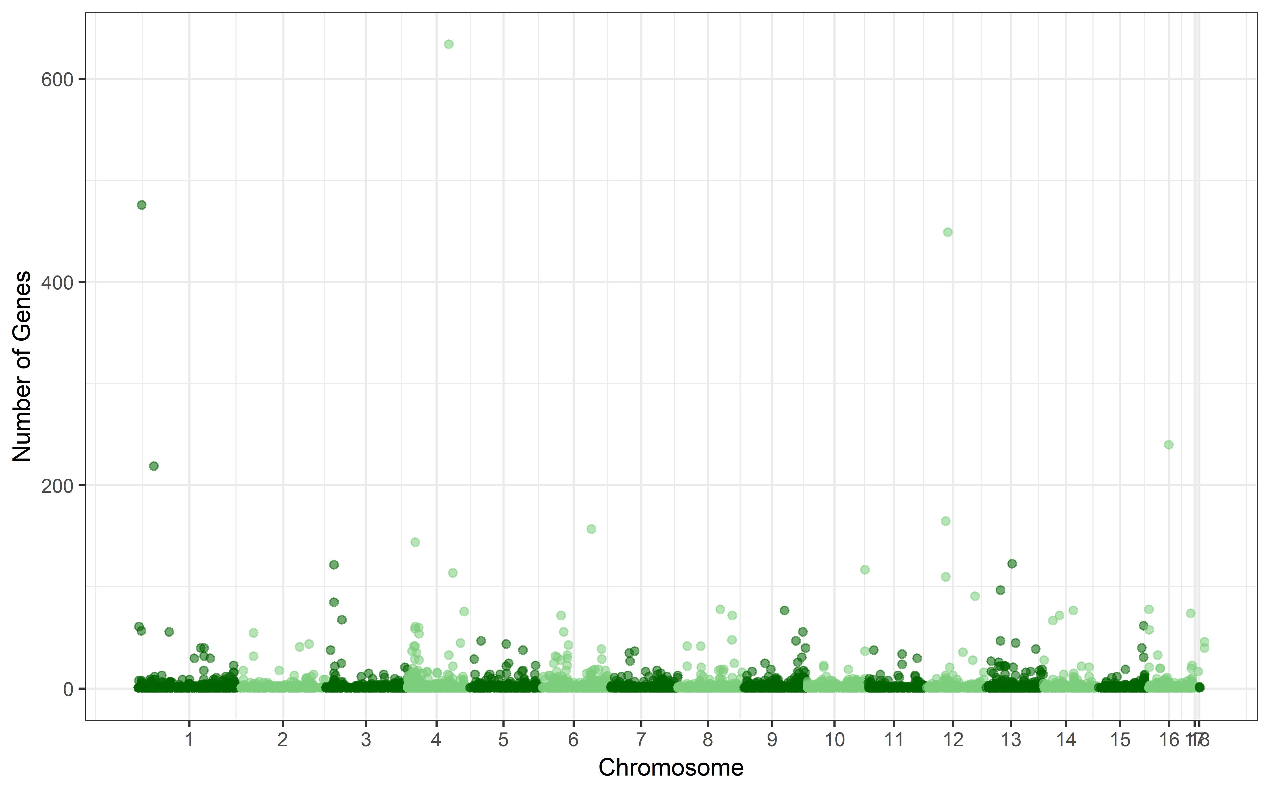
a.
150
100
Number of Genes
50
0
1 2 3 4 5 6 7 8 9 10 11 12 13 14 15 16 17 18
b.
Chromosome
600
400
Number of Genes
200
0
1 2 3 4 5 6 7 8 9 10 11 12 13 14 15 16 17 18
Figure 4. Manhattan-type plot of GEMMA results of transcriptome-wide B. cinerea and A. thaliana expression phenotypes. Panel a is a Manhattan-type plot of the top 1 SNP hit per B. cinerea transcript on Col-0 A. thaliana. Panel b is a Manhattan-type plot of the top 1 SNP hit per A. thaliana transcript when infected by B. cinerea.
Notes:
Figure N6.

Slide 5
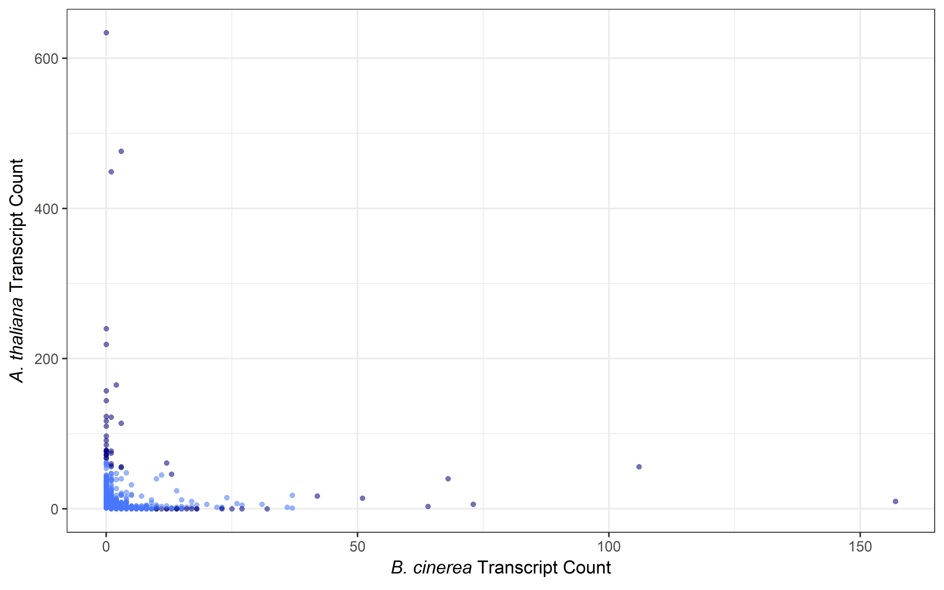
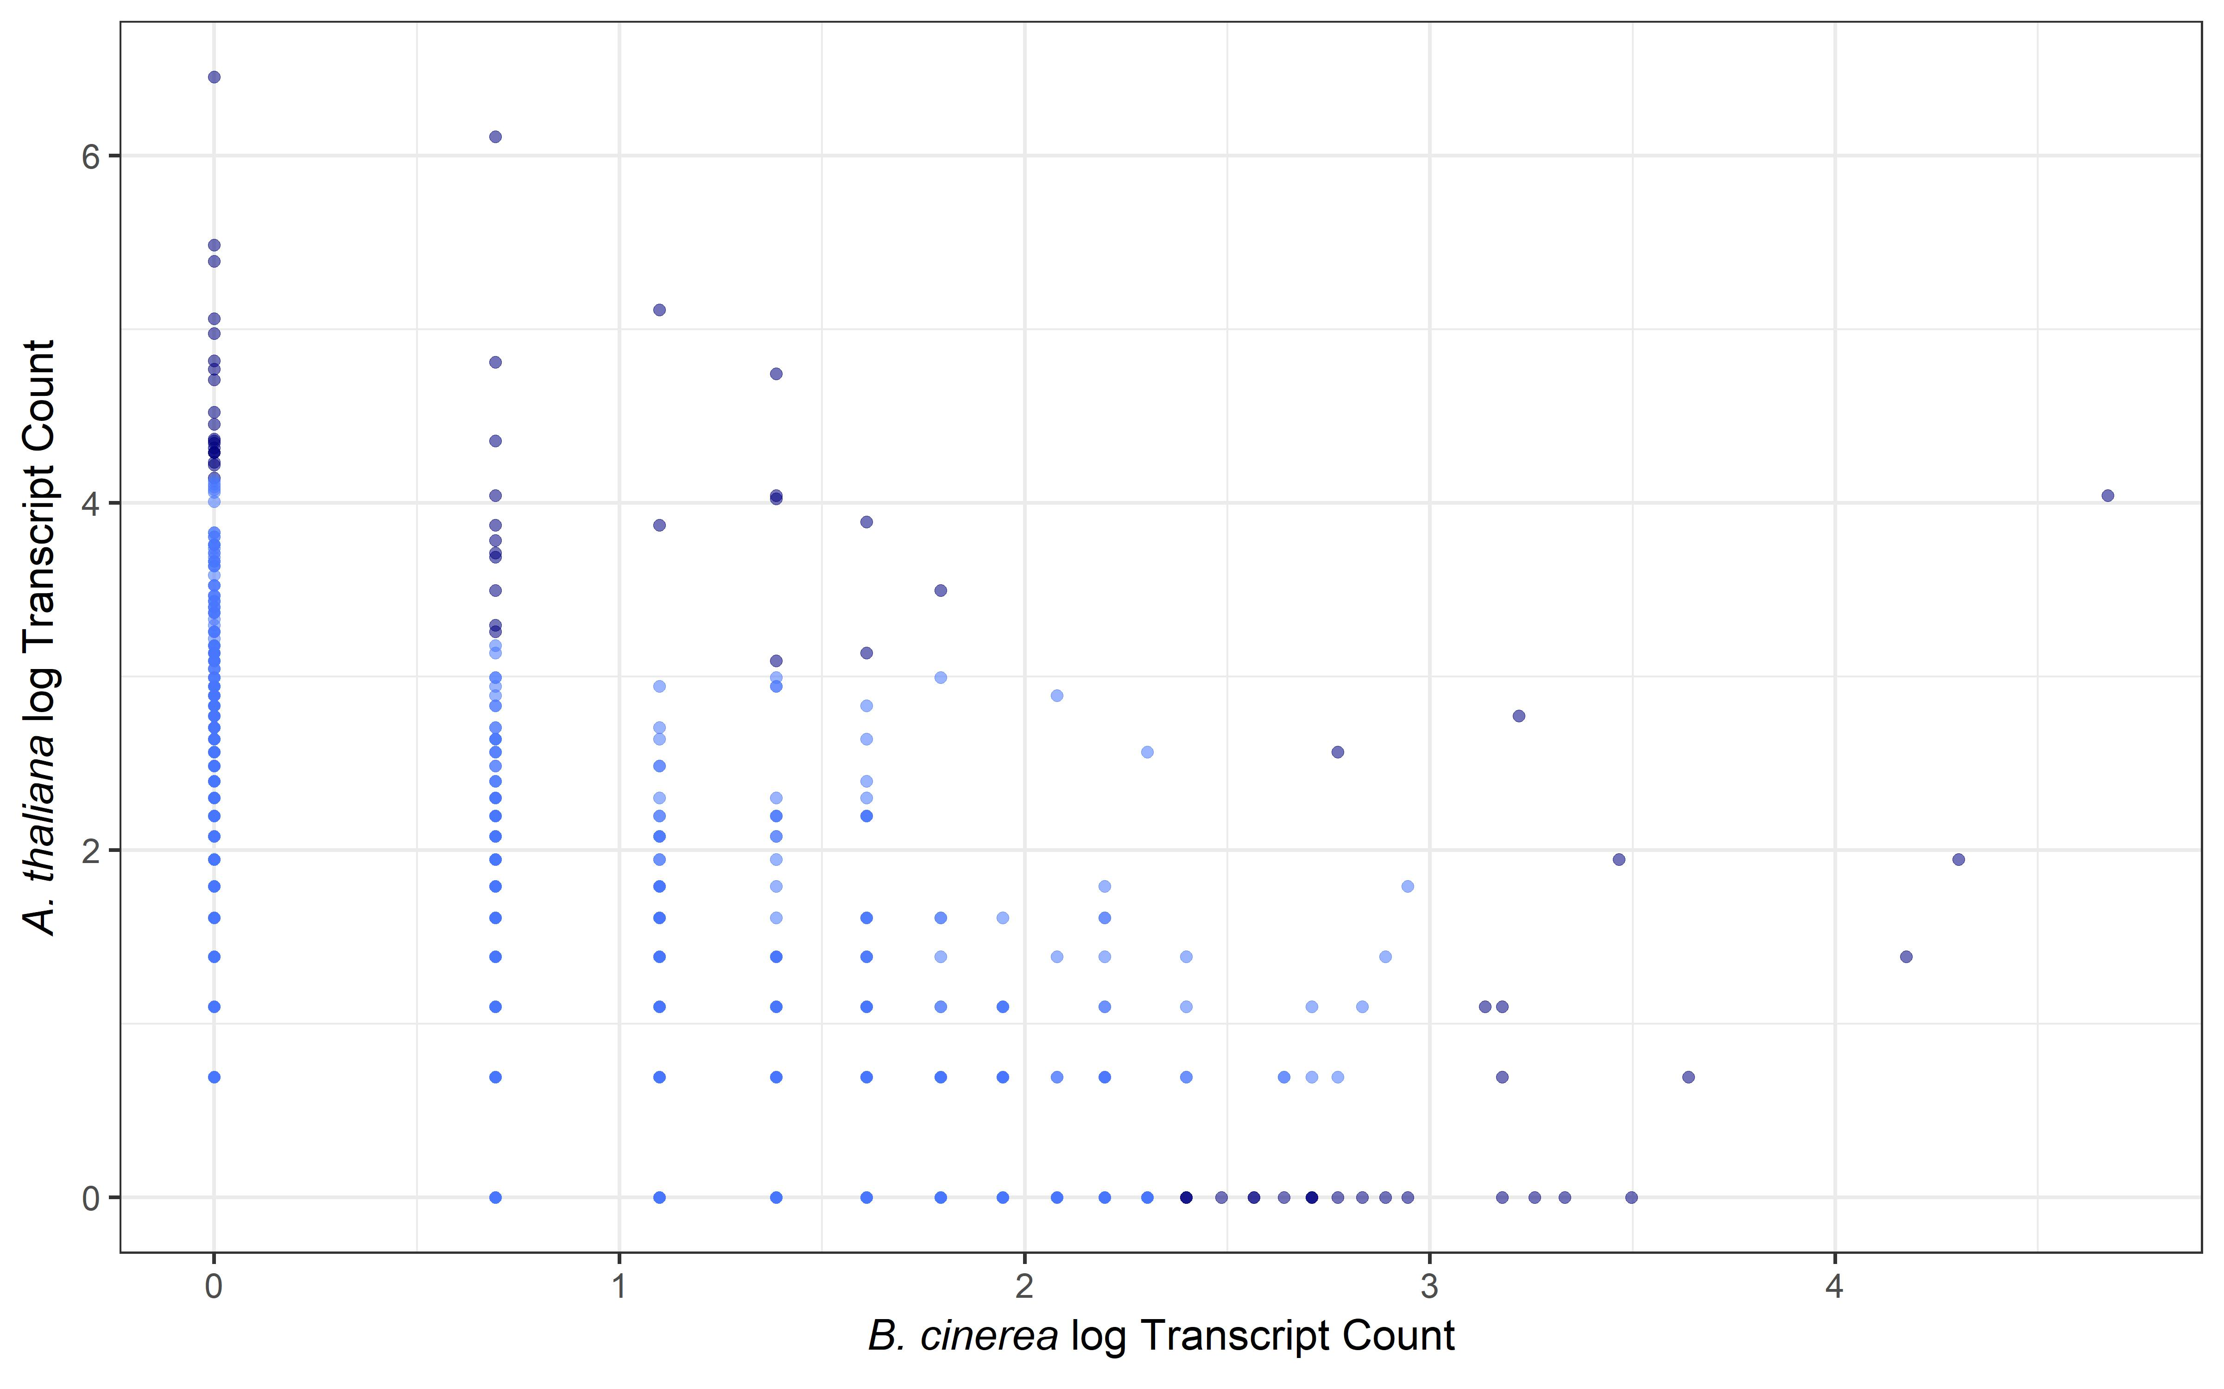
a.
600
400
A. thaliana Transcript Count
200
0
0 50 100 150
b.
B. cinerea Transcript Count
6
4
A. thaliana log( Transcript Count)
2
0
0 1 2 3 4
B. cinerea log(Transcript Count)
Figure 5. Interspecific hotspot comparison on the B. cinerea genome. For each SNP that is a top hit for one or more transcripts, the number of associated transcripts is counted, across both the B. cinerea transcriptome and the A. thaliana transcriptome.

Slide 6
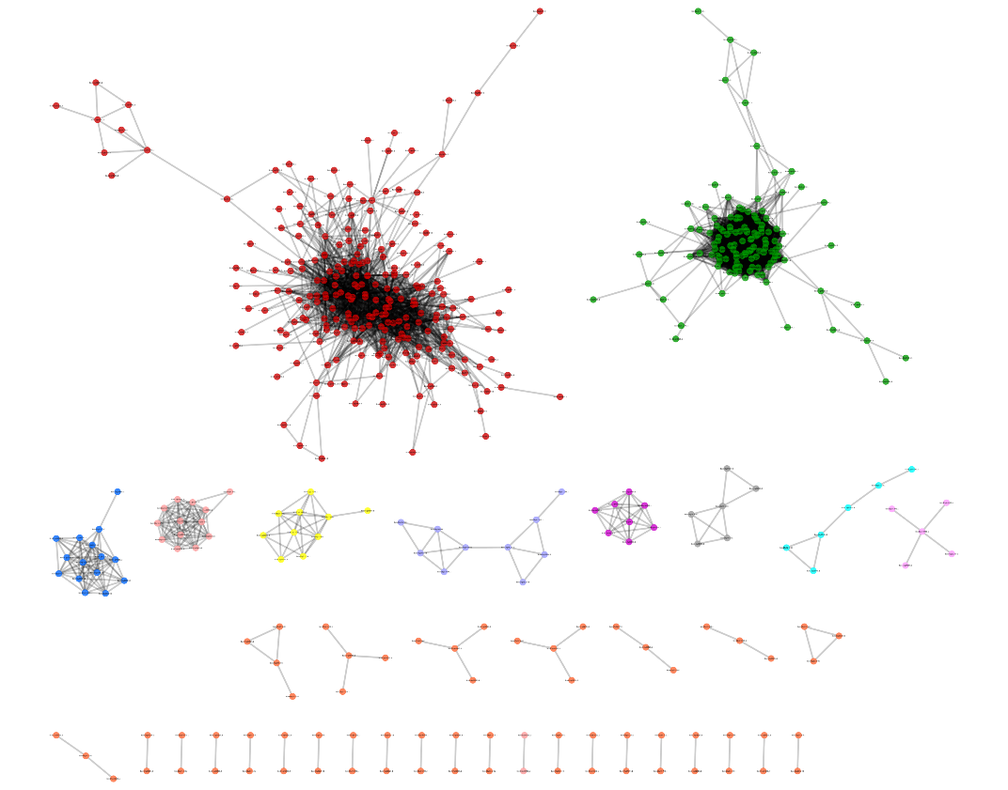
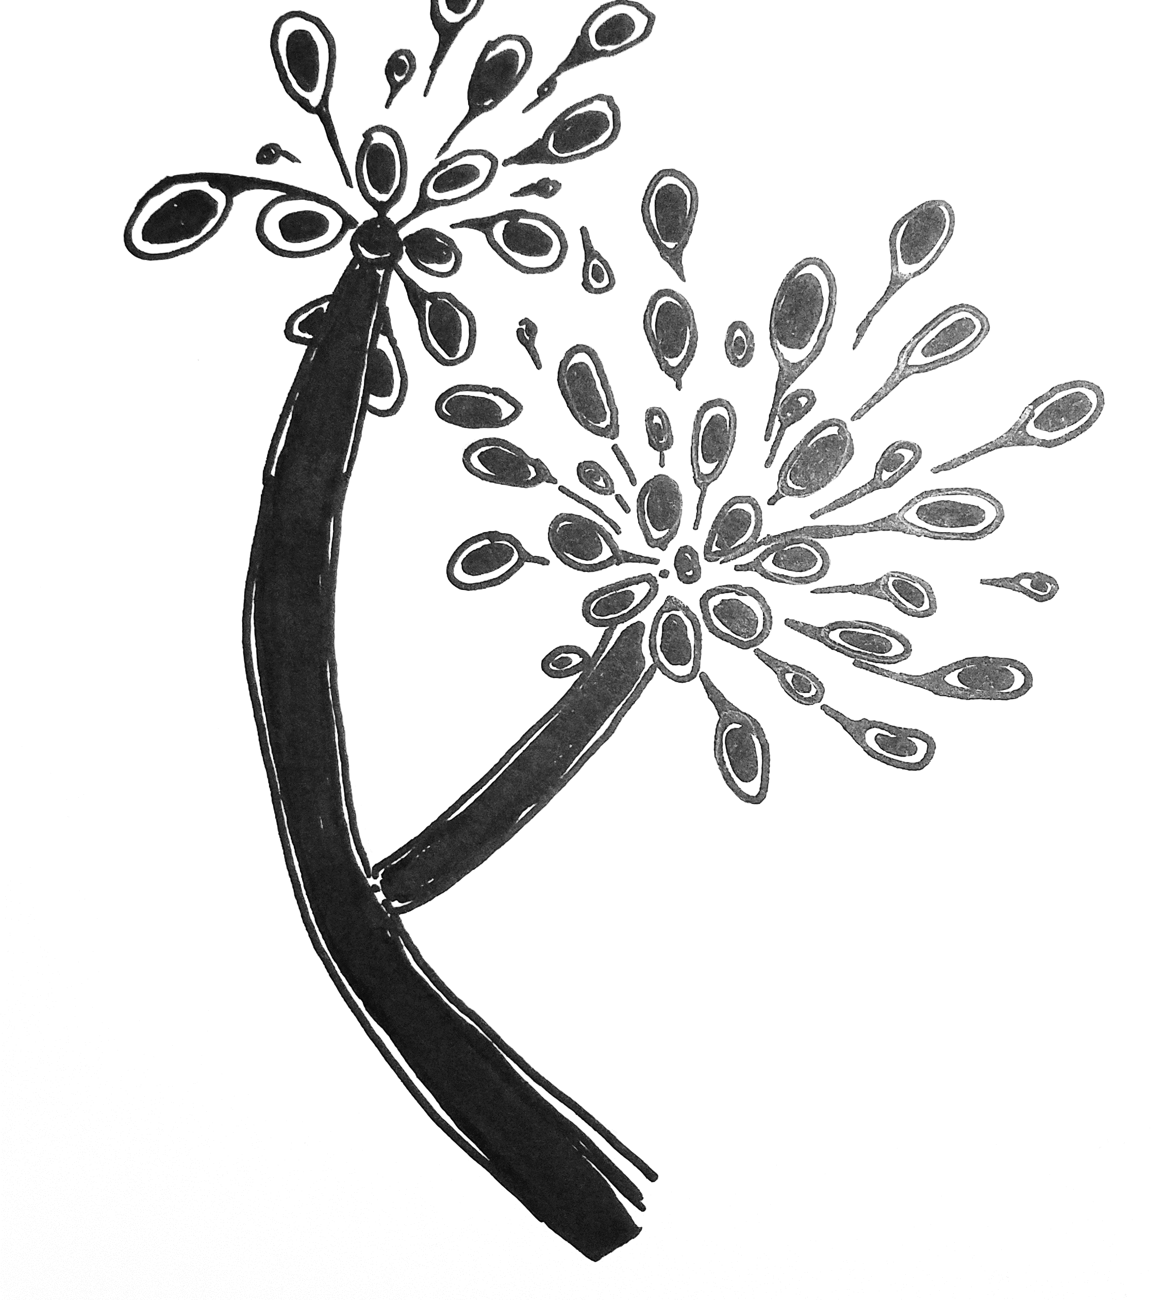
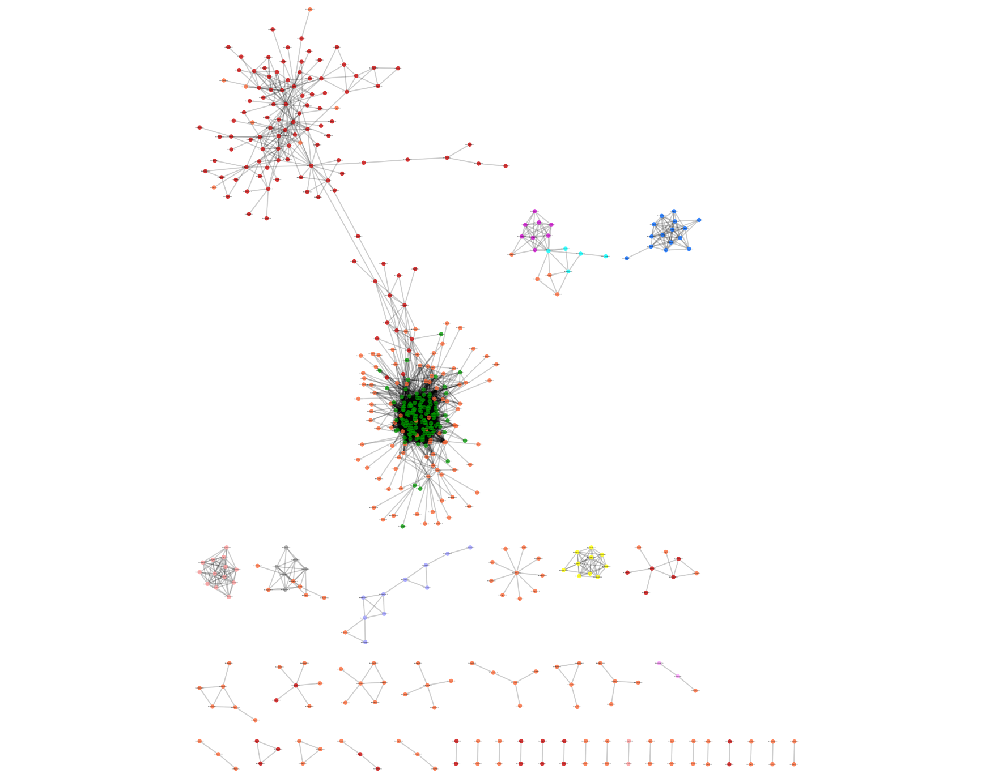
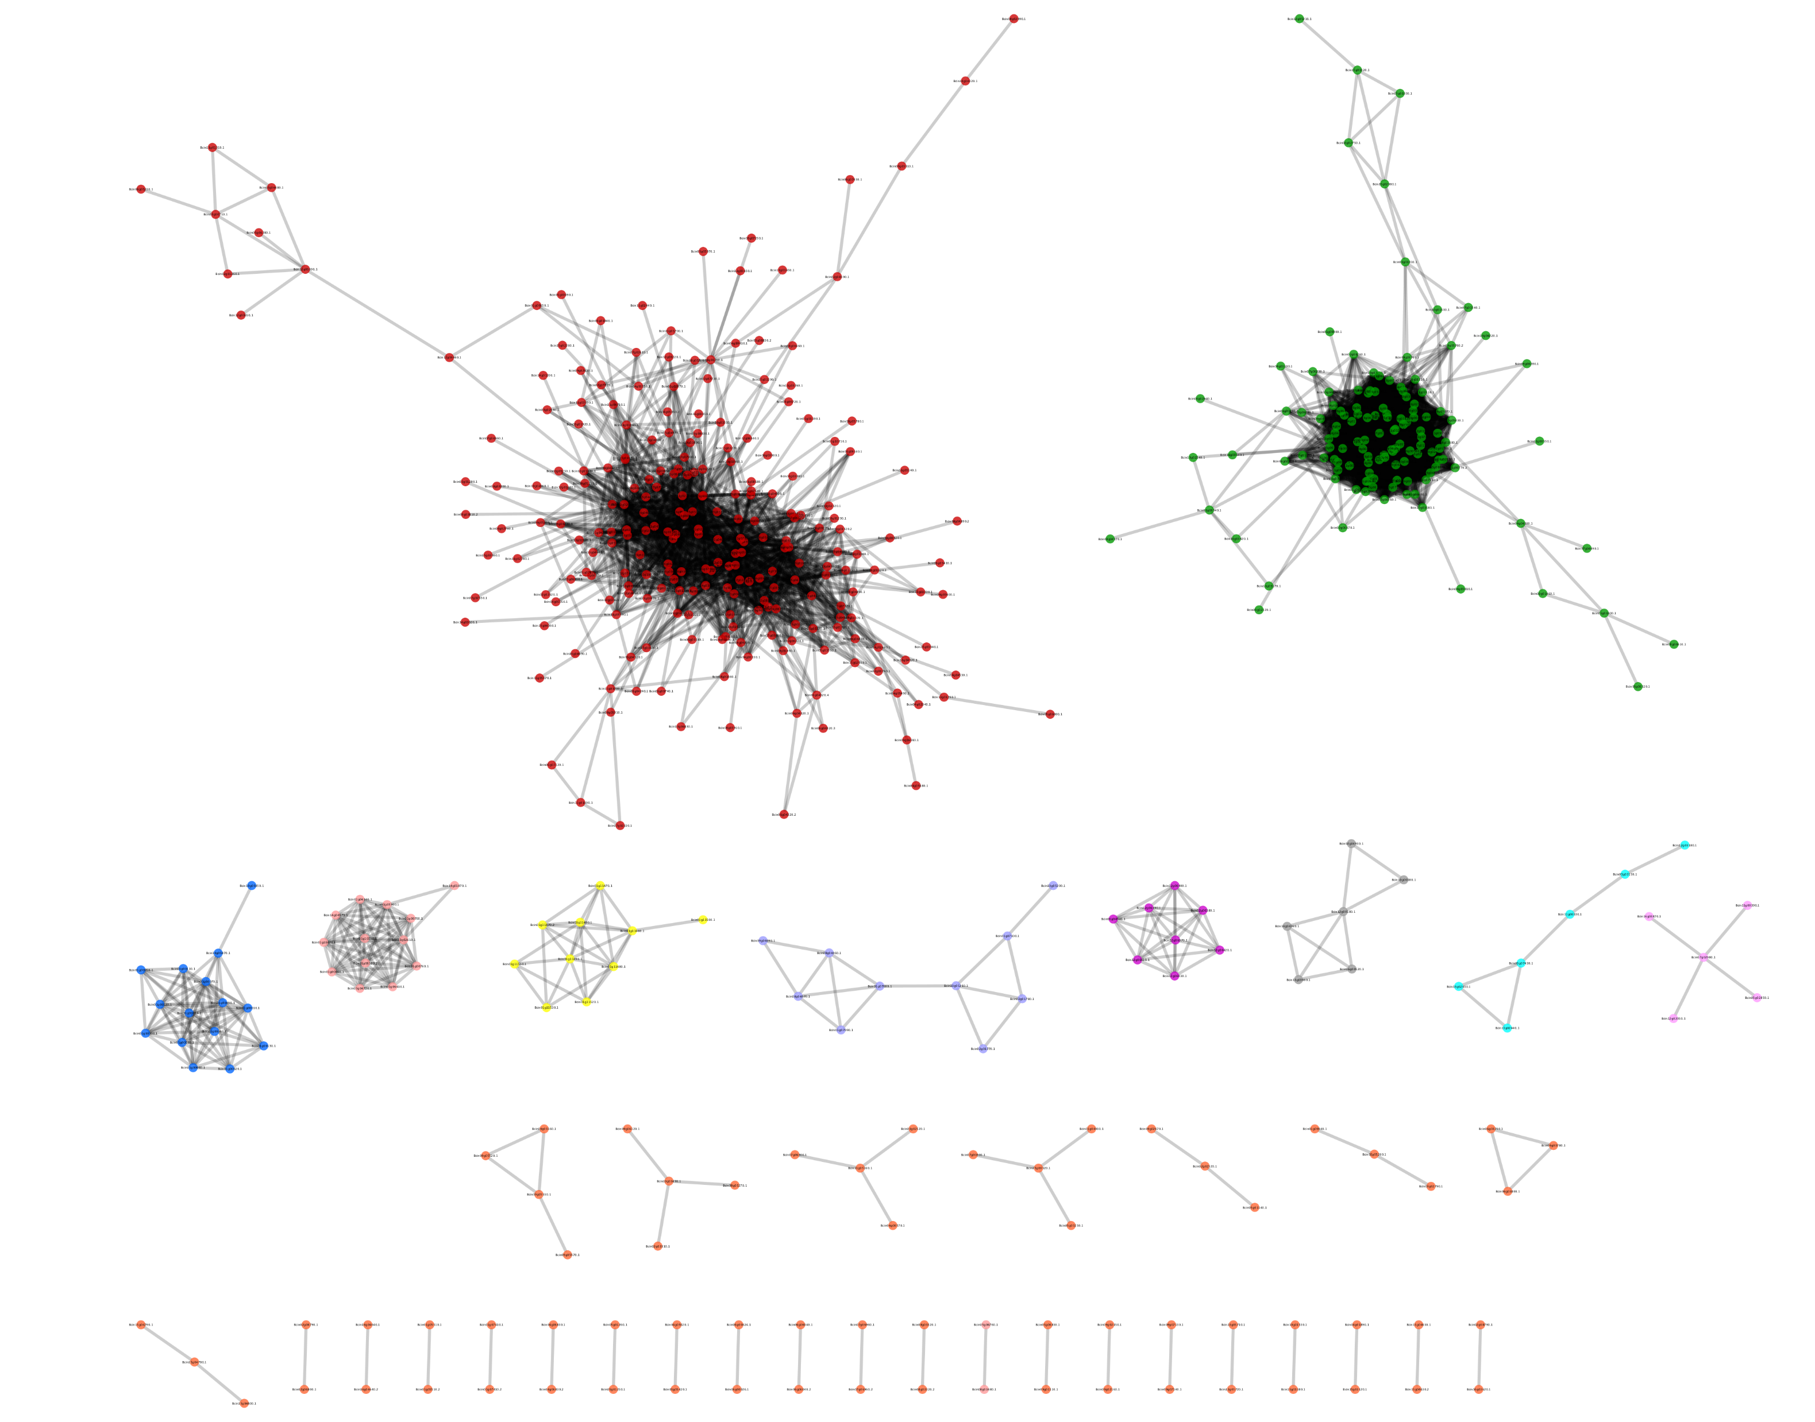

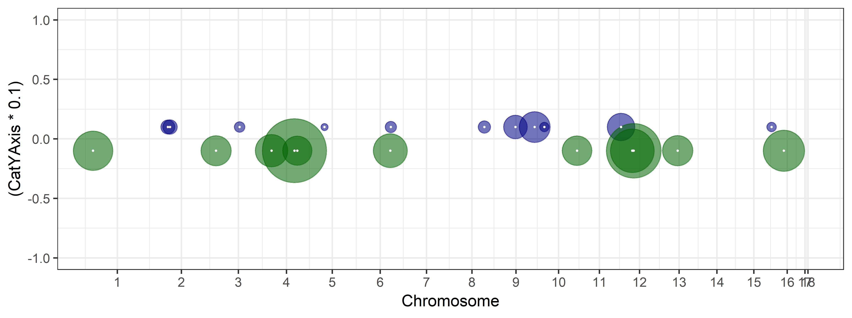
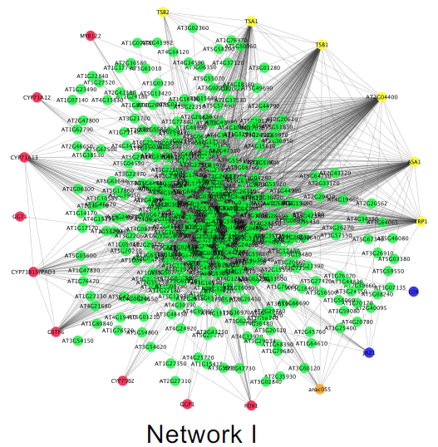
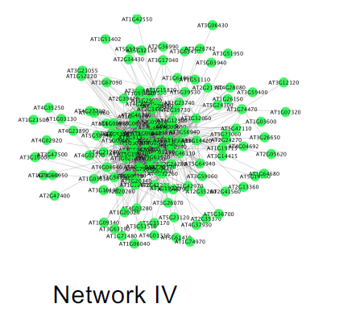
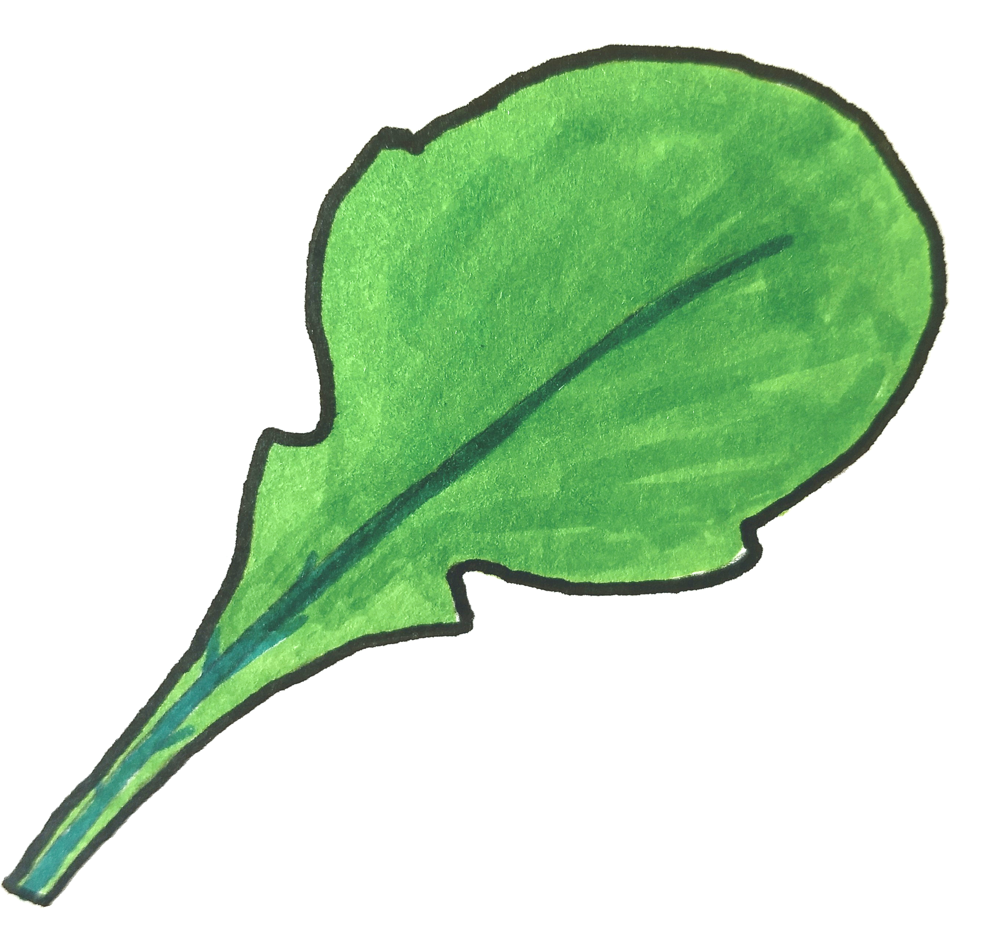
Vesicle/Virulence
Exocytosis Regulation
TSL/Growth
Peptidase
JA/ SA/ Cam
photosynthesis
Figure 6. Genes linked to eQTL hotspots are in virulence and defense co-expression networks. Circles along the B. cinerea genome map are eQTL hotspots, centered at the gene containing the eQTL and with radius proportional to the number of transcripts linked to this hotspot. The gene center is marked with a white dot. Hotspots for B. cinerea transcripts are drawn in blue, hotspots for A. thaliana transcripts are drawn in green. The network names are based on biological functions from gene ontology analysis of network members, from Figure 4 of Zhang et al. 2018 and Figure 6 of Zhang et al. 2017. The A. thaliana networks depicted are the most inclusive of the host-dependent networks, from npr1-1. Links between hotspots and co-expression networks are drawn according to the number of genes shared between them. Variable line weight represents the percent of hotspot target genes shared with the co-expression network; 1-25% is dashed, 25-50% is dotted, 50-75% is solid, 75-100% is heavy solid.

